Slide 1
Objectives
In this session, you will:
  Understand the effectiveness of presentation
  Identify the process of preparing a presentation

Slide 2

Introduction to Presentation
Presentation is a way of communicating ideas, messages, and information.
Presentation can be:
  Formal
  Informal

Slide 3
Importance of an Opening Statement
The opening statement of a presentation should be good. A good start:
  Provides you confidence.
  Provides a positive impression to the participants.
  Grabs the attention and interest of the participants.

Slide 4

Factors of an Effective Presentation
Different factors that need to be taken care of by the presenter for an effective presentation are:
  Body language
  Voice
  Rapport building skills
  Content knowledge
  Mode of delivery

Slide 5

Factors of an Effective Presentation (Contd.)
Consider the following aspects of your body language for making presentation effective:
  Smile as much as you can.
  Check your floor movement.
  Control your facial expressions.
  Maintain an appropriate posture.
  Keep nodding frequently.
  Avoid chewing gums.

Slide 6
Factors of an Effective Presentation (Contd.)
  Avoid standing in front of the slide or flip chart.
  Use black or blue marker.
  Use capital bold letters.
  Avoid writing long sentences.
  Dress professionally.
  Avoid any bias.
  Avoid looking at floor/walls/ ceiling/ out of the window.
  Avoid staring.

Slide 7

Factors of an Effective Presentation (Contd.)
Consider the following aspects of your voice:
  It should be audible.
  It should use clear vocabulary and diction.
  It should use correct rate of speech.
  It should be modulated.

Slide 8

Factors of an Effective Presentation (Contd.)
Consider the following aspects to build rapport:
  It should have a mutual respect.
  Give ample recognition to the participants.
  Understand the participant’s view point.
  Call the participants by their first name.
  Be honest and do not portray yourself as “know all”.
  Appreciate participants’ input.

Slide 9

Factors of an Effective Presentation (Contd.)
Consider the following aspects while you develop content:
  It should have a natural flow of learning.
  It should have an objective, agenda, and a summary.
  It should include all relevant information.
  It should include figures and graphs.
  It should be visible.
  It should include the results of any calculation.

Slide 10
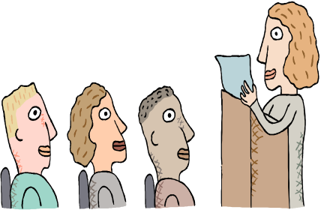

Factors of an Effective Presentation (Contd.)
Consider the following aspect while you choose mode of delivery:
  It should be prepared according to the type of presentation.

Slide 11
Do’s and Don’t s of an Effective Presentation
You need to remember the following do’s and don'ts while delivering a presentation:
  Never read from the slides or handouts directly.
  Speak clearly and audibly.
  Learn the name of each participant as quickly as possible.
  Do not put too much of information on a single slide.
  Do not fiddle with objects such as marker or pen when giving presentation.
  Do no turn your back to the audience often.
  Do not be proud of your superior knowledge.

Slide 12
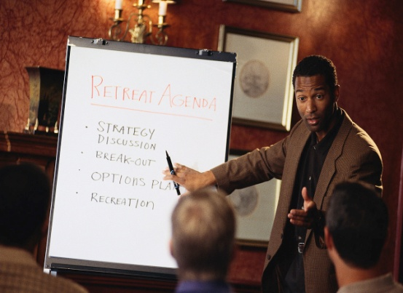
Preparing the Presentation
While preparing the presentation, you need to focus on:
  Defining the objective.
  Analyzing the audience and their expectations.
  Preparing a script.
  Adding visual appeal.
  Rehearsing before presentation.

Slide 13

Format of the Presentation
An effective presentation comprises of the following six stages:
  Ice-breaking
  Opening
  Discussing the need
  Presenting the idea/message
  Accumulating the results
  Summarizing

Slide 14



Handling Stage Fright
Stage fright is an initial fear of a presenter to present in front of the audience/participants.
Consider the following tips to handle stage fright:
  Remember your successful experience.
  Visualize your successful presentation.
  Boost your confidence.
  Relax yourself.
  Trust your message.
  Keep smiling.
  Talk to yourself.
  Get familiar with the venue.

Slide 15
Activity: Prepare a Presentation
Prepare a presentation on any of the following topic:
  Demonstration of a new mobile
  Highlighting the facilities of a hospital
  Launch of a new car
  Importance of maintaining customer’s data
  Highlighting the facilities of a new restaurant

Slide 16
Summary
In this session, you learned that:
  Presentation is a way of communicating ideas, messages, and information.
  Presentation can be formal or informal.
  Different factors that constitute an effective presentation are:
    Body language
    Voice
    Rapport building skills
    Content knowledge
    Mode of delivery

Slide 17
Summary (Contd.)
  The processes of preparing a presentation includes:
    Defining the objective.
    Analyzing the participants.
    Preparing script.
    Adding visual appeal.
    Rehearsing before presentation.
  The six stages of a presentation are:
    Ice-breaker
    Opening
    Discuss need for an idea
    The idea
    Accruing results/benefits
    Summary

Slide 18
Summary (Contd.)
  Stage fright is an initial fear of a presenter to present in front of the audience/participants.
  Tips to handle the stage fright are:
    Memorize your successful experience.
    Visualize your successful presentation.
    Boost your confidence.
    Relax yourself.
    Trust your message.
    Keep smiling.
    Talk to yourself.
    Enjoy yourself.
    Get familiar with the venue.

